Slide 1

General Safe Practices for Working with Nanomaterials in Research Laboratories
Erfaneh Ghassami
Isfahan University of Medical Sciences

Slide 2
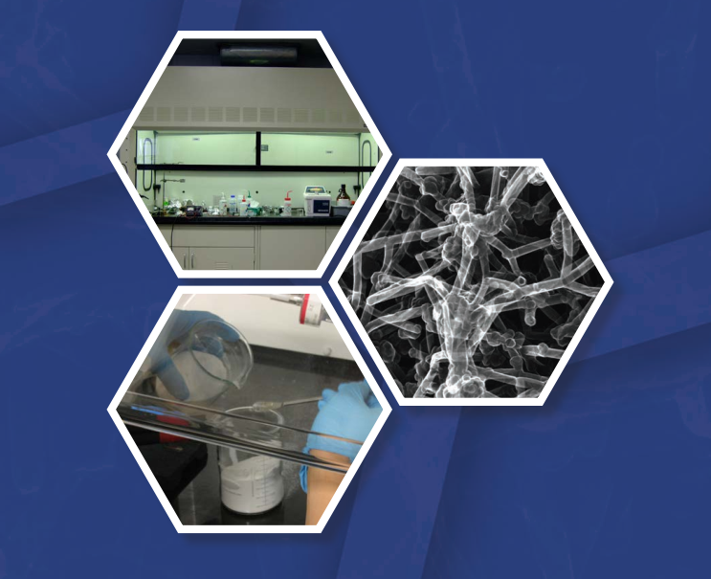

Slide 3
Risk Management
Hazard Identification
Exposure Assessment
Exposure Control

Slide 4
Hazard Identification
Nano-object / Nanomaterial ?
Scope? Pilot scale

Slide 5
Exposure Assessment
Potential routs of exposure
Inhalation ➔ Deposit in respiratory tract
Systemic circulation
Nose to brain→ olfactory region
Dermal exposure ➔ Topical
Systemic
Ingestion ➔ Hand-to-mouth
Mucociliary escalator system
Who is at risk?

