Slide 1

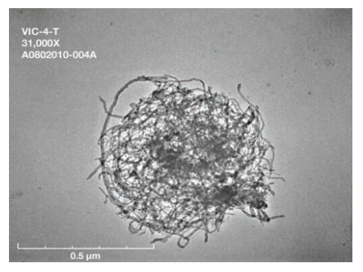
Aerosol droplets containing nanomaterials ejected from vial during sonication

Slide 2
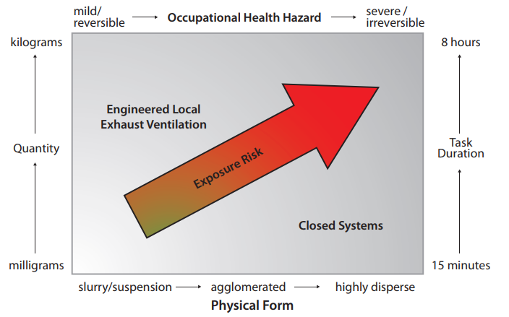
Factors influencing control selection

Slide 3
Recommendations for Exposure Control
Elimination or Substitution
Isolation and Controls
Administrative Controls
Personal Protective Equipment

Slide 4
Isolation and Engineering Controls
Containment
Ventilation
General exhaust ventilation (GEV)
Local exhaust ventilation

Slide 5
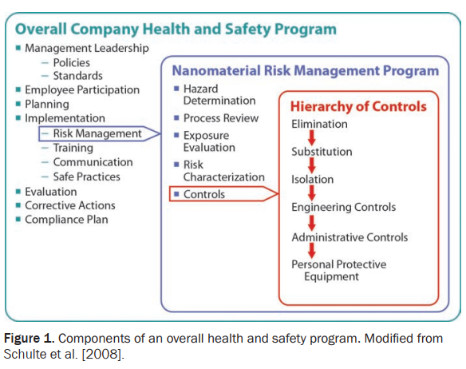

Slide 6
Administrative Controls
Training
Labeling and Storage

Slide 7
Personal Protective Equipment
Protective Clothing
Respirators

Slide 8
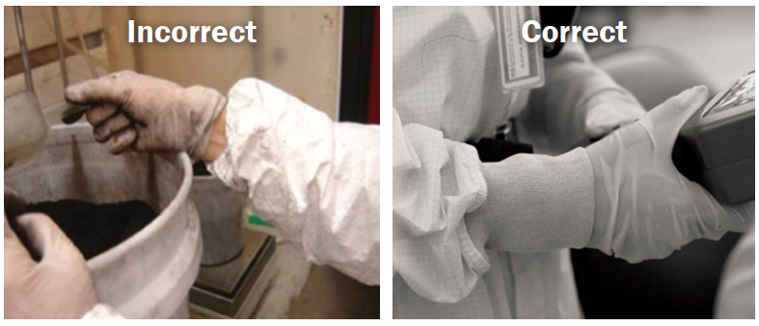
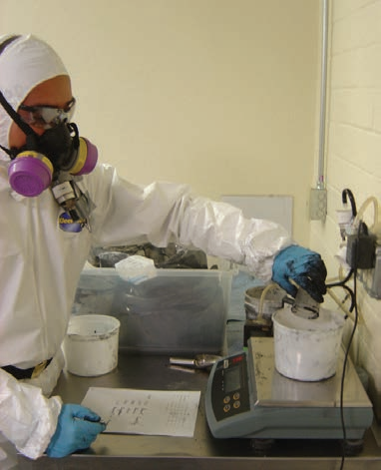

Slide 9
Local Exhaust Ventilation

Slide 10
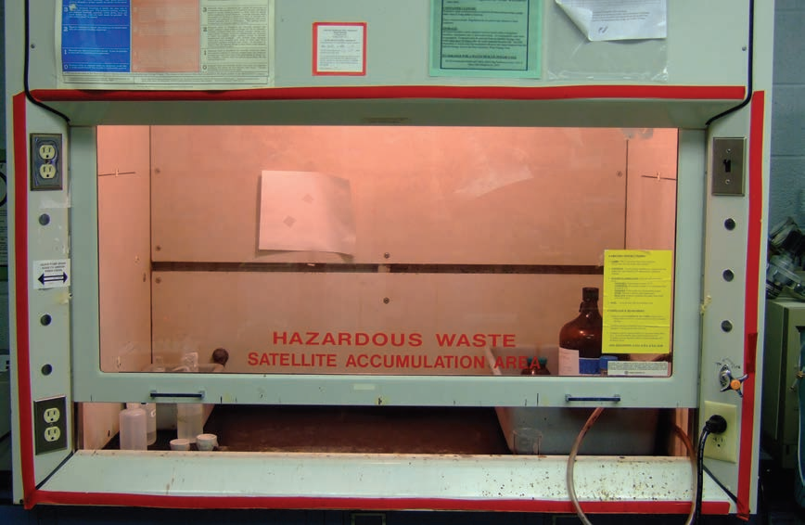
Conventional (constant-flow) laboratory chemical hood

Slide 11
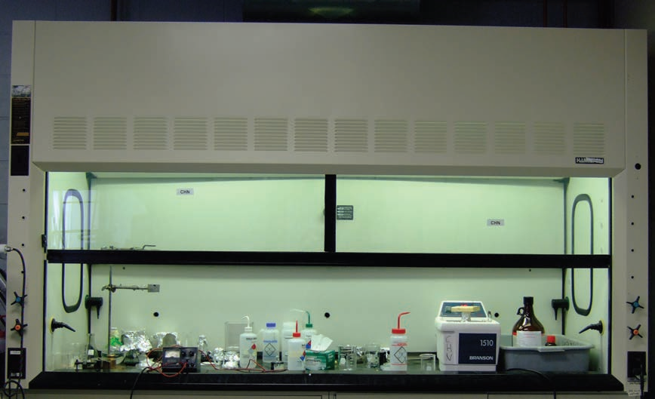
Laboratory bypass hood

Slide 12
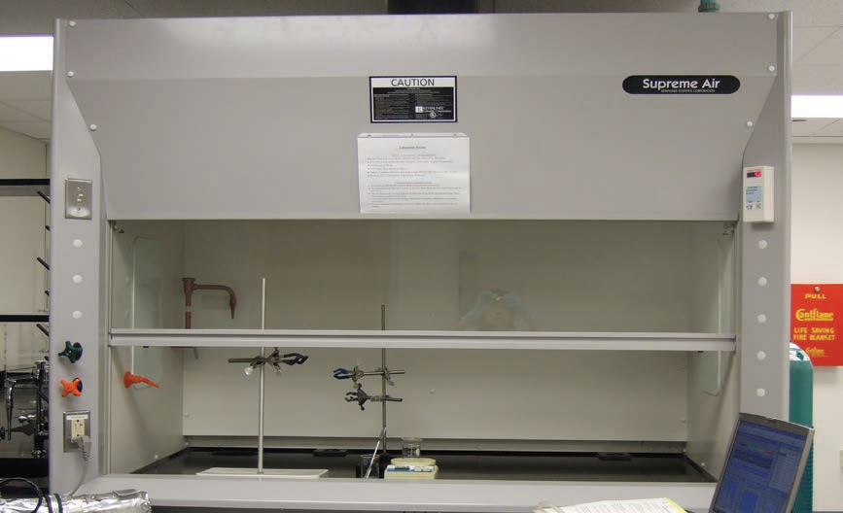
Laboratory constant-velocity hood

Slide 13
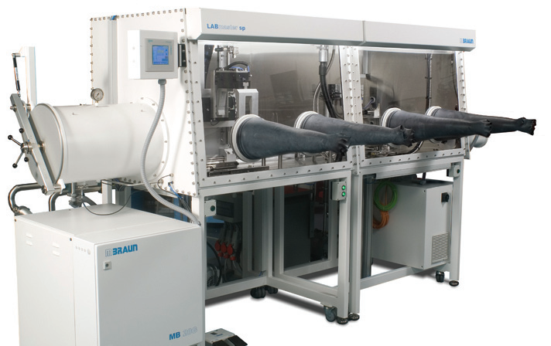
Glove box enclosure

Slide 14
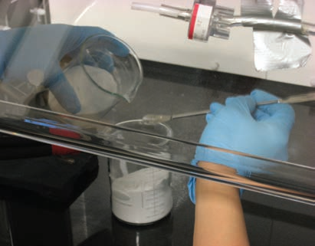
Close-up of a nanopowder transfer operation.

Slide 15
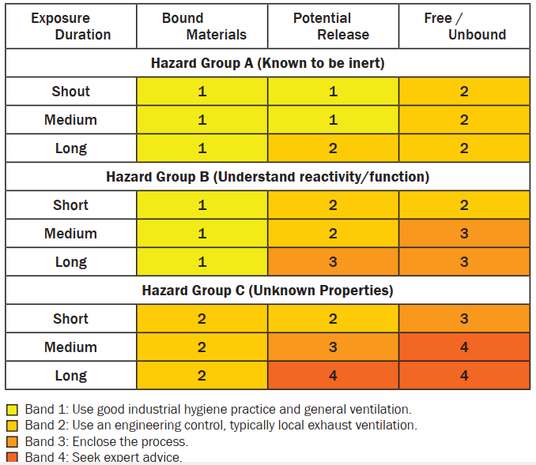

Slide 16
Fire and Explosion Control

Slide 17
Management of Nanomaterial Spills
Barricade tape
Nitrile or other chemically impervious gloves
Elastomeric respirator with appropriate filters
Adsorbent material
Wipes
Sealable plastic bags
Walk-off mat
HEPA-filtered vacuum
Spray bottle with deionized water or other appropriate liquid

Slide 18
Thank You

