Slide 1
به نام او
کارگاه ایمنی مواد شیمیائی
دکتر محبوبه رستمی

Slide 4
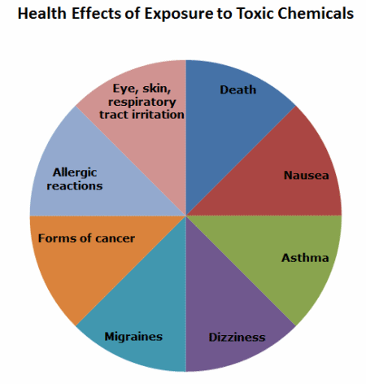

Slide 5
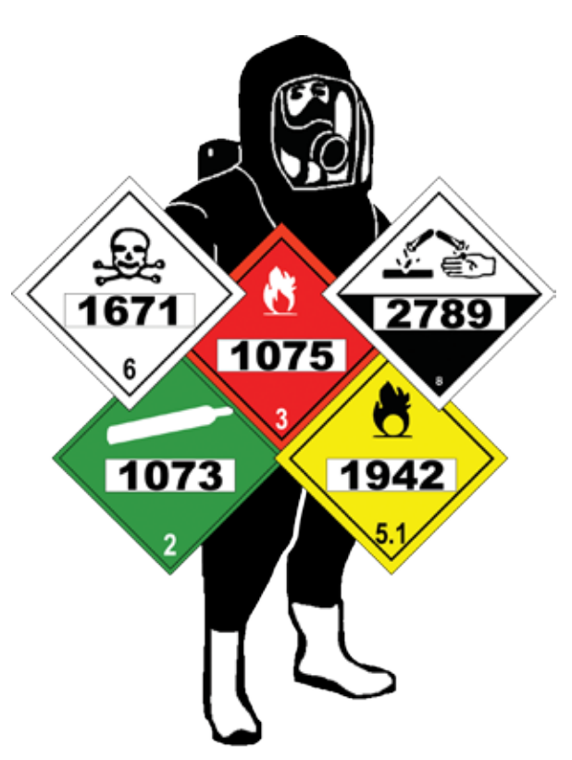
Categories of Hazardous Chemicals
Corrosive
Flammable
Toxic
Reactive
Biological (infectious)
Carcinogen (cancer-causing)
Radioactive
Notes:
I. Background for the Trainer:
If an MSDS is available for a specific chemical, distribute it to the class or read the information that applies.
II. Speaker’s Notes:
Companies must keep inventories of their hazardous chemicals.
This inventory will allow companies to determine which categories of chemicals they have.
Most of this information should be covered in a company’s Hazard Communication Program.

Slide 6
Physical States of Hazardous Materials
Liquid
Solid
Gas
Vapor
Notes:
I. Speaker Notes:
It is important for the users of chemicals to know what physical state they are in.
The physical state can affect the routes of exposure, or how the chemical can enter and harm your body.

Slide 7
How to Handle Chemicals Properly
Use cautions
Always follow procedures
Read all labels
Keep yourself and the work area clean
Plan ahead
Notes:
I. Speaker’s Notes:
Handling chemicals safely involves a lot of common sense; however, learning and understanding specifics about the chemical is very important.
Always use caution when using chemicals. Follow all the proper procedures every time. Taking shortcuts could result in accidents.
The first thing you should do before using any chemical is to read the container label —it will give you the basic hazards and precautions associated with the chemical.
Plan ahead when using chemicals. Have all the PPE, equipment, and other items you need nearby.

Slide 8
Routes of Exposure
Inhalation
Ingestion
Absorption
Injection
Notes:
I. Speaker’s Notes:
These are the four primary routes of exposure.
The most common route is inhalation because most chemicals are used in the liquid state; therefore, if they are volatile, they will give off vapors that can be inhaled when in the breathing zone.
Ingesting does not mean drinking a chemical. Ingestion can occur when eating or drinking after using a chemical.
Absorption means evaporating through skin contact or mucous membranes.
Injection usually occurs by accidental needlepricks or sharp injuries.

Slide 9
Symptoms of Possible Overexposure
Eye discomfort
Breathing difficulty
Dizziness
Headache
Nausea
Vomiting
Skin irritation
Notes:
I. Speaker’s Notes:
Should you or anyone you know suffer any of these symptoms while working with chemicals, seek medical attention immediately and report the incident to your supervisor.

Slide 10
Incompatible Chemicals
Flammables and oxidizers
Flammables and any ignition source
Acids and cyanides
Strong acids and strong alkalines
Concentrated acids and water
Organic solvents and corrosives
Corrosives and other reactive materials
Notes:
I. Speaker’s Notes:
Severe consequences can result from mixing the chemicals listed on this slide.
These events include:
Fire
Explosion
Chemical Reactions
Release of Heat (Energy)
Splashing and Spattering
Degradation of materials

Slide 11
Agencies That Regulate Hazardous Chemical Storage
Occupational Safety and Health Administration (OSHA)
National Fire Protection Association (NFPA)
Environmental Protection Agency (EPA)
Department of Transportation (DOT)
Notes:
I. Speaker’s Notes:
Companies that use hazardous chemicals will be regulated by any and all of these agencies, depending on the specific use.
OSHA deals with the productive use of chemicals.
NFPA deals with flammable and combustible chemicals.
EPA deals with wastes associated with hazardous chemicals.
DOT deals with the transportation of hazardous chemicals.

Slide 12
General Safety Tips (cont.)
Never smell or taste a chemical to identify it
Know all emergency procedures and equipment
Always read labels’ MSDSs prior to use
Store all hazardous chemicals properly
Always use hazardous chemicals as intended
Notes:
I. Speaker’s Notes:
Prior to using a chemical, obtain all available information so that you have additional information about the chemical.
To identify any chemical, read the label and refer to the Material Safety Data Sheet. These tools will give you all the information you need to work safely with the chemical.

Slide 13
Primary Container Labels
Identity of the hazardous chemical
Appropriate hazard warnings
Name and address of the manufacturer or importer
Target organ effects
Notes:
I. Speaker Notes:
Chemical labels give you basic information at a glance, including:
The identity of the chemical
The hazard warnings
The name and address of the manufacturer
Target organ effects, or the organs of your body that could be harmed by using the chemical.
You can not deface the manufacturer’s label or cover it with a label of your own.

Slide 14
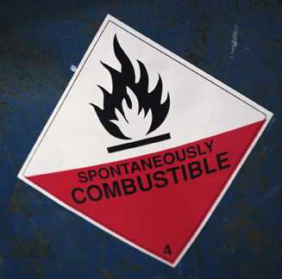
Secondary Container Labels
Identity of the hazardous chemical
Hazard warning information
Notes:
I. Speaker’s Notes:
Secondary containers are those that a chemical is transferred to.
Make sure that secondary containers are labeled with this information so that the user can adequately trace the material back to the original container for additional hazard information.

Slide 15
Handling Chemical Emergencies
Know emergency phone numbers
Know how to control the spill
Know proper equipment shutdown procedure
Know proper evacuation routes and assembly areas
Notes:
I. Background for the Trainer:
If your company has existing emergency procedures for dealing with chemicals, show it to the class at this time.
II. Speaker’s Notes:
If employees are uncertain how to handle the emergency, they should evacuate the area and let someone else handle it.
Information on this slide is contained in our Emergency Action Plan. It’s covered by a different OSHA standard, 29 CFR 1910.38.

